Slide 1
固体力学和流体力学的基本方程

Slide 2
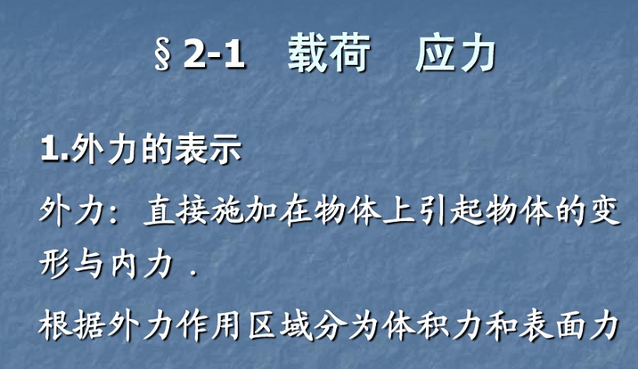
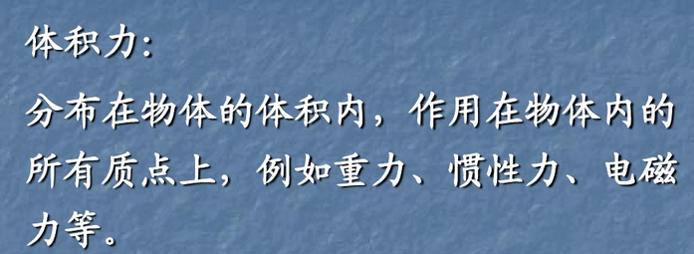

Slide 3
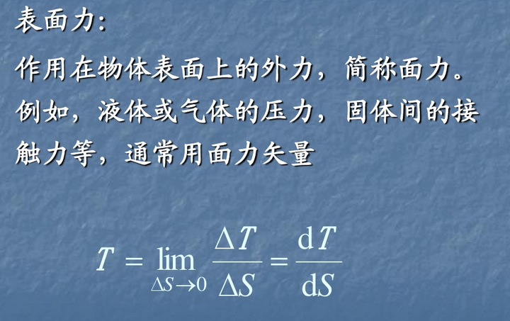

Slide 4
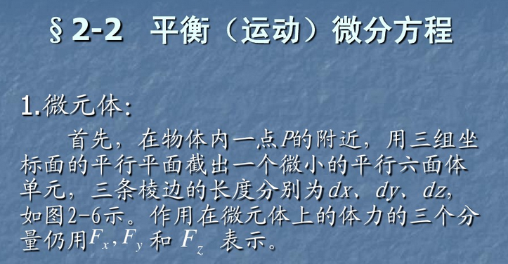
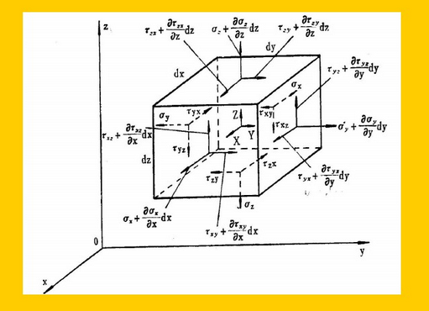

Slide 6
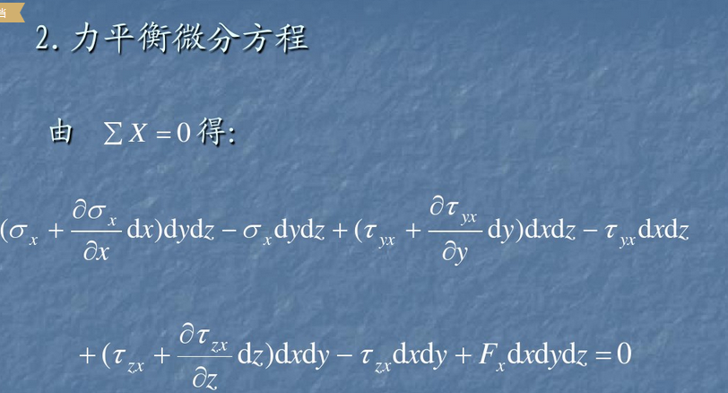

Slide 7
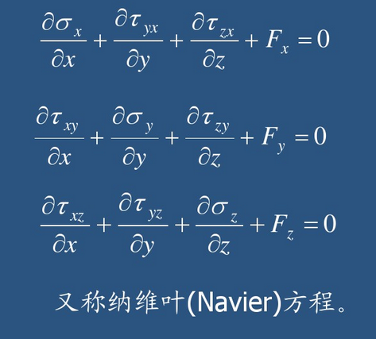

Slide 8
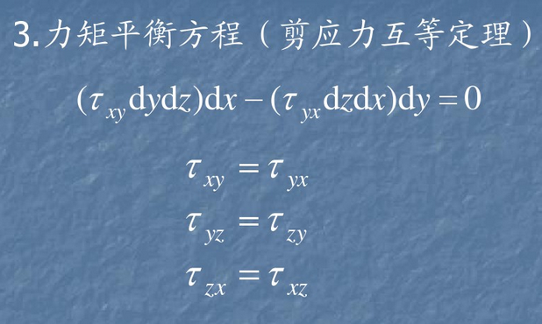

Slide 9
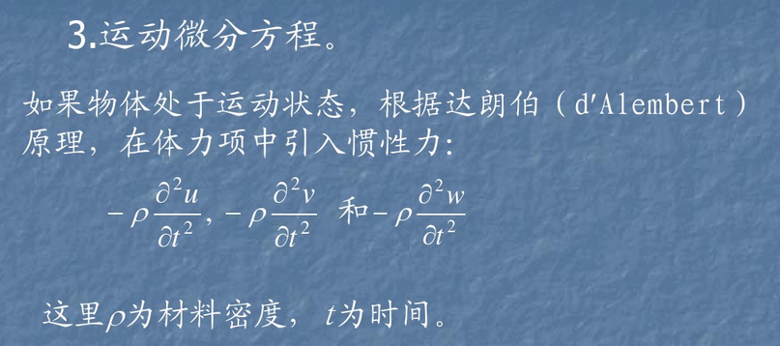

Slide 10
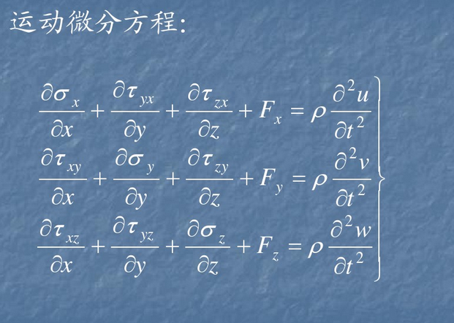

Slide 11
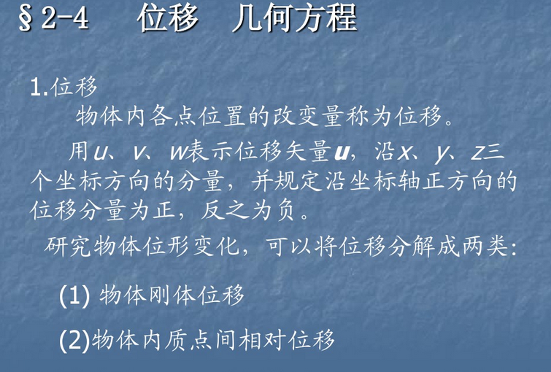

Slide 12
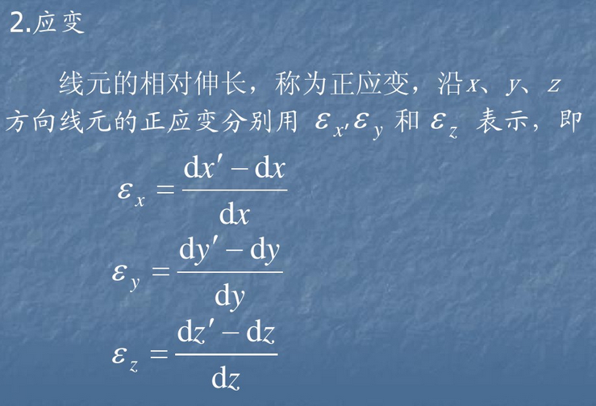

Slide 13
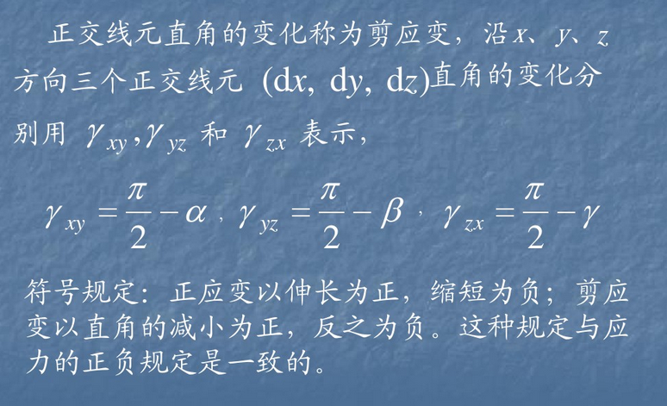

Slide 14
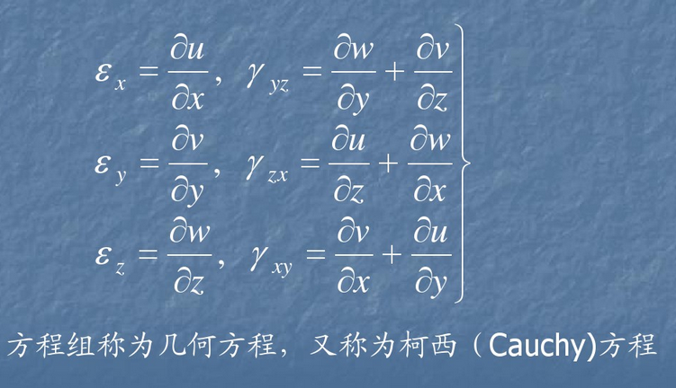

Slide 15
材料力学部分基本概念

Slide 16
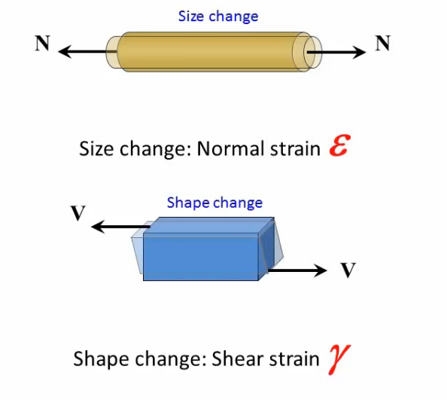

Slide 17
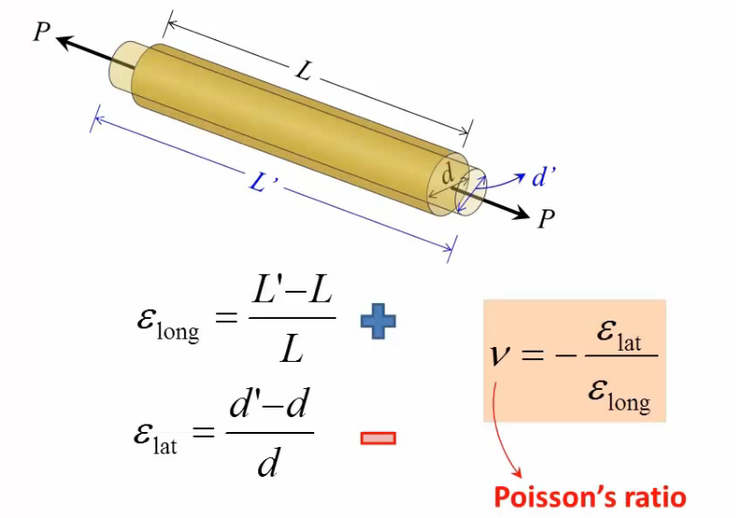

Slide 19
Properties of ν
Absolute values of ν are used in calculations.
The value of ν is about:
0.25 for a perfectly isotropic elastic materials.
0.33 for most metals.

Slide 20
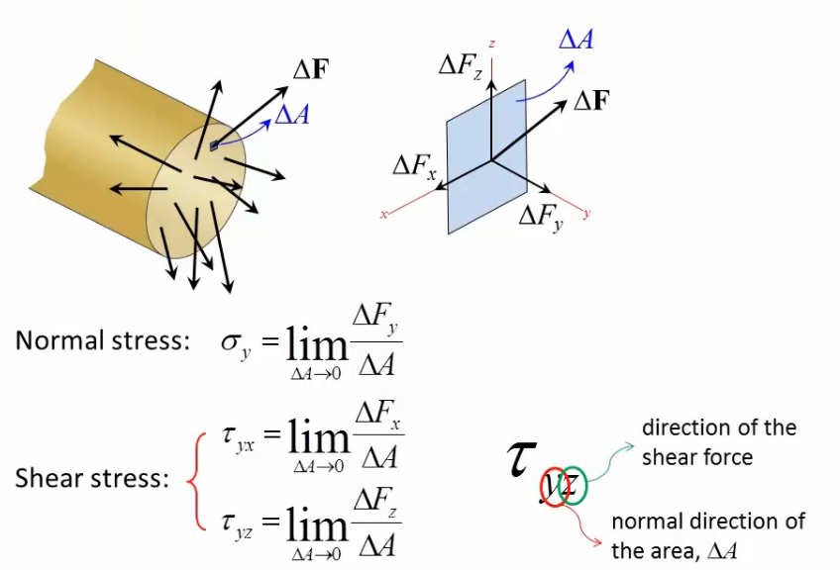

Slide 21
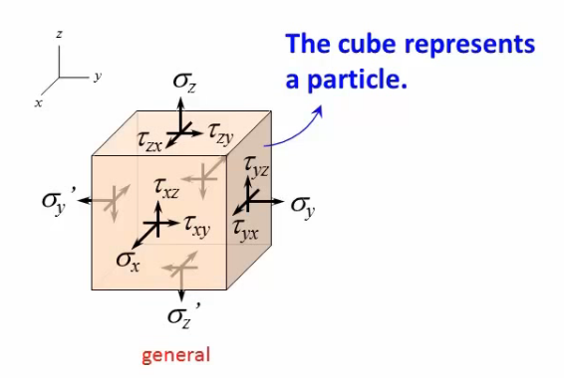
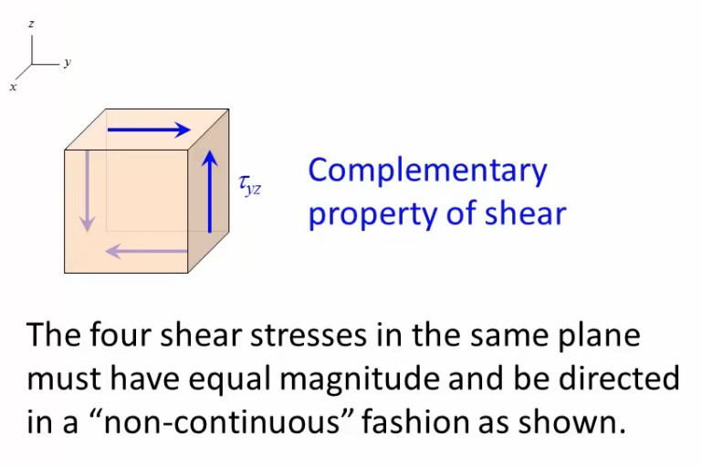
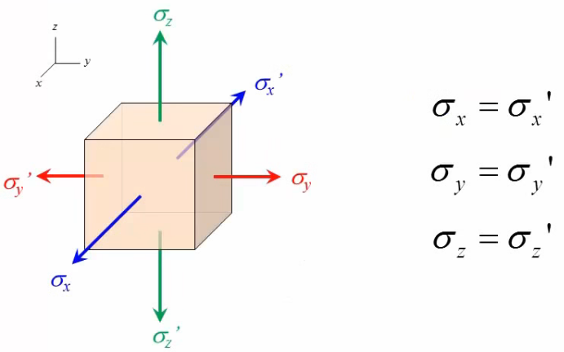

Slide 22
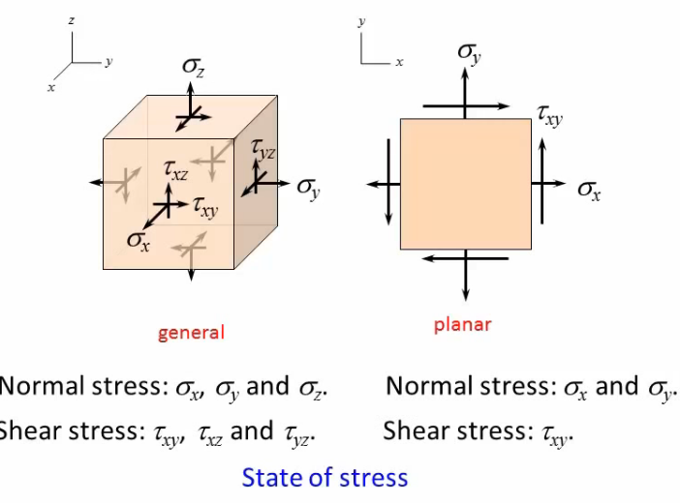

Slide 23
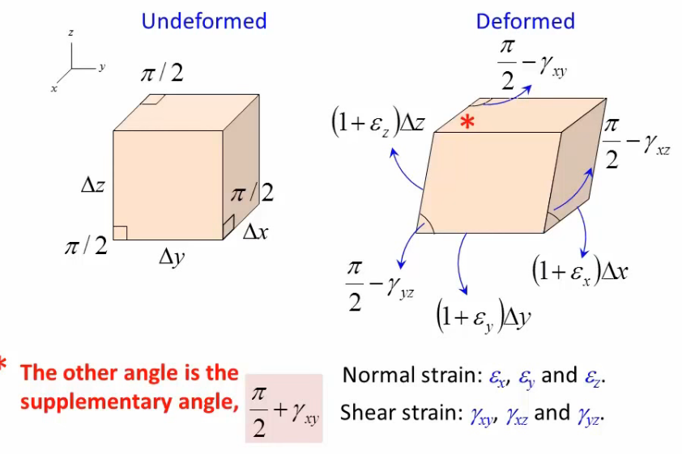

Slide 24
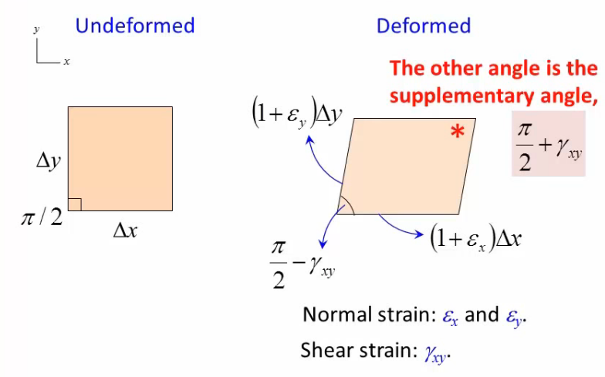

Slide 25
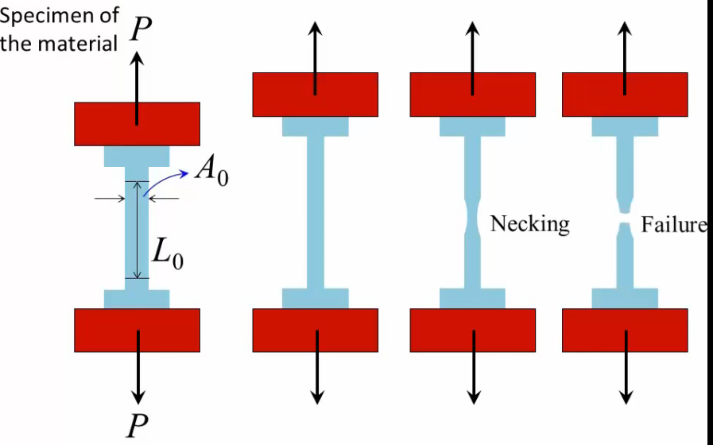
力学测试的基本方法， 中文书 第 63页

Slide 26
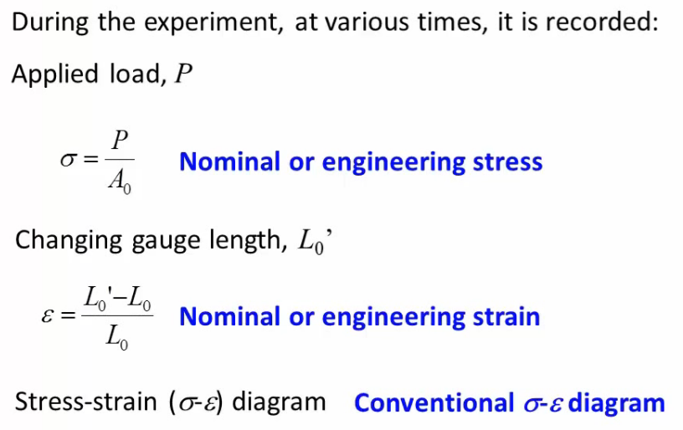

Slide 27
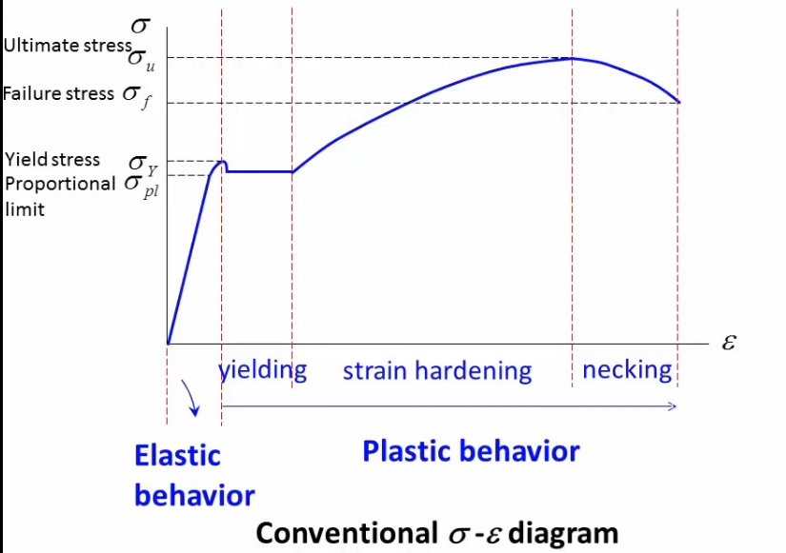

Slide 28
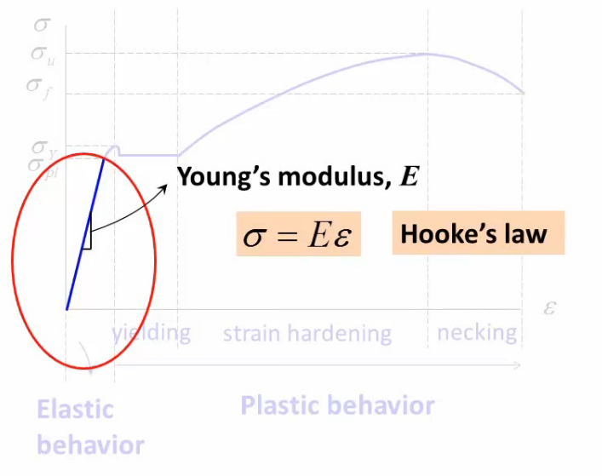

Slide 29
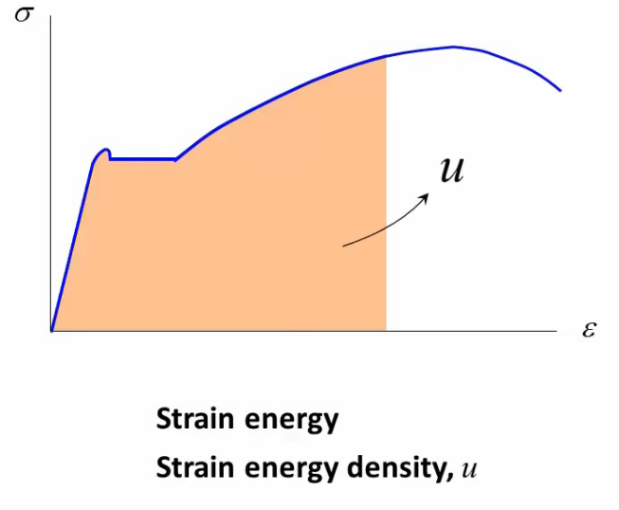
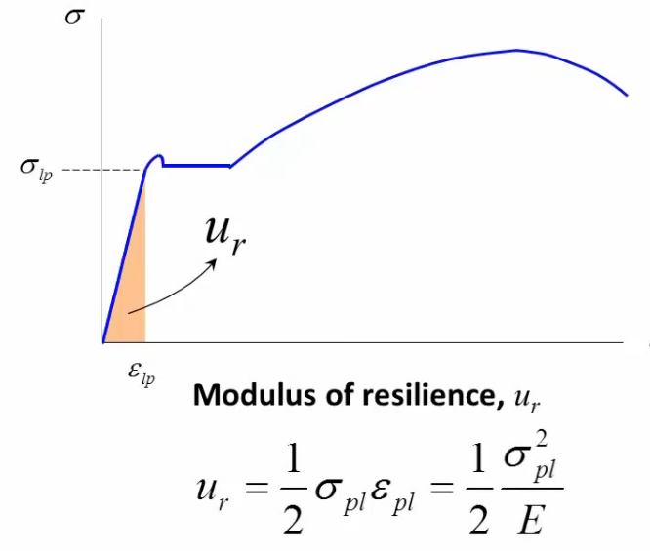
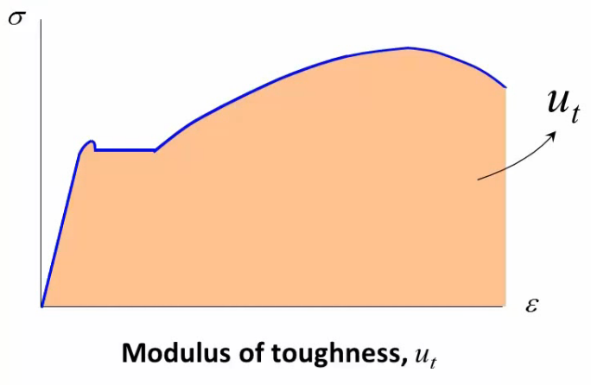
回弹模量
韧性模数

Slide 30
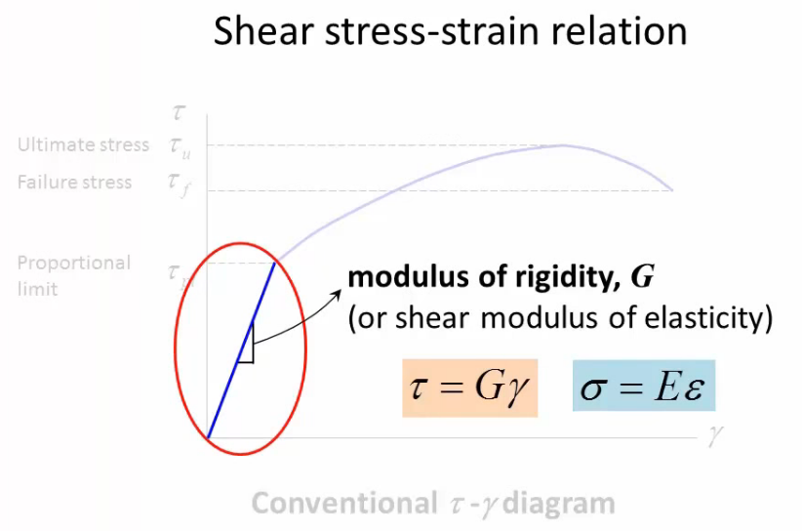

Slide 31
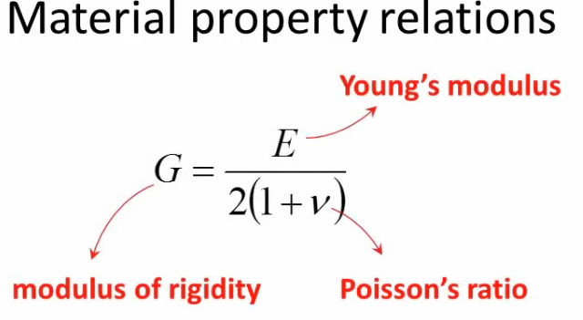

Slide 32
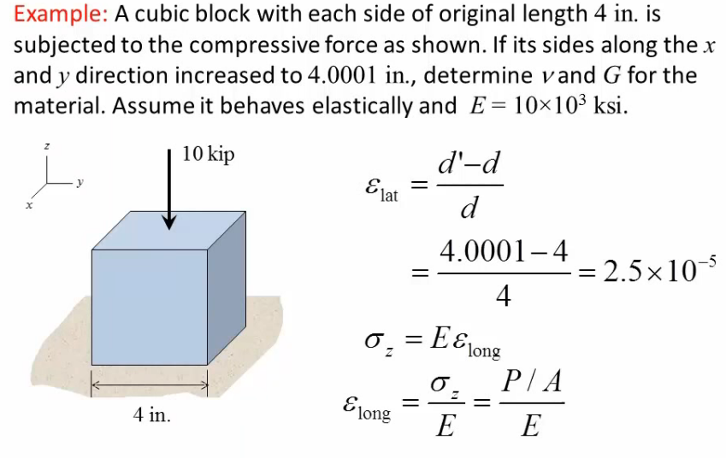
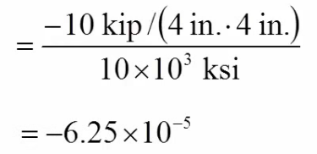

Slide 33
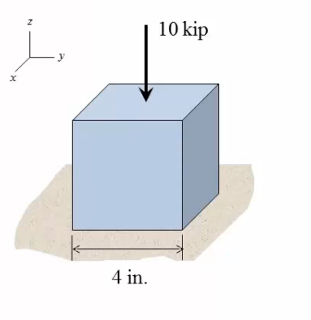
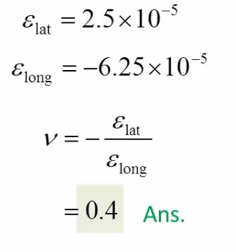
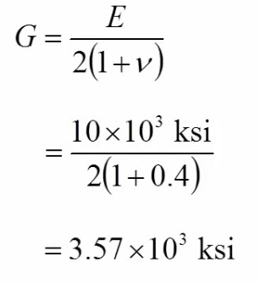

Slide 34


Slide 35
The stress, σ_{x} in the x-direction produces 3 strains:
longitudinal strain (extension) along the x-axis of:
transverse strains (contraction) along the y and z -axes, which are related to the Poisson’s ratio:
(6.7)
(6.8)

Slide 36
In order to determine the total strain produced along a particular direction, we can apply the principle of superposition.
For Example, the resultant strain along the x-axis, comes from the strain contribution due to the application of σ_{x}, σ_{y} and σ_{z}.
σ_{x} causes: in the x-direction
σ_{y} causes: in the x-direction
σ_{z} causes: in the x-direction
Applying the principle of superposition (x-axis):
(6.9a)

Slide 37
The situation can be summarized by the following table:
Table 6 -1 Strain Contribution Due to Stresses
_____________________________________________________
Stress Strain in the Strain in the Strain in the
x direction y direction z direction

Slide 38
By superposition of the components of strain in the x, y, and z
directions, the strain along each axis can be written as:
(6.9)

Slide 39
Special Cases
Plane Stress (σ₃ = 0): This exists typically in:
a thin sheet loaded in the plane of the sheet, or
a thin wall tube loaded by internal pressure where there is no stress normal to a free surface.
Recall Eqs. 6-9, and set σ_{z} = σ₃ = 0.
Therefore,
(6.15a)
(6.15b)
(6.15c)

Slide 40
力矩
Moment and mass moment of inertia
转动惯量
质量转动惯量
面积转动惯量

Slide 41
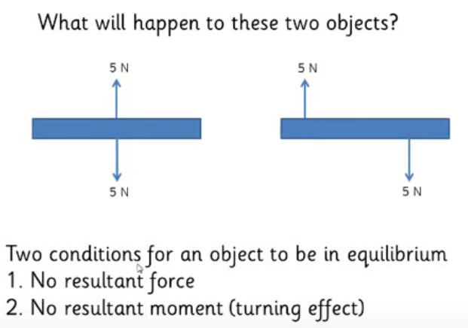

Slide 42
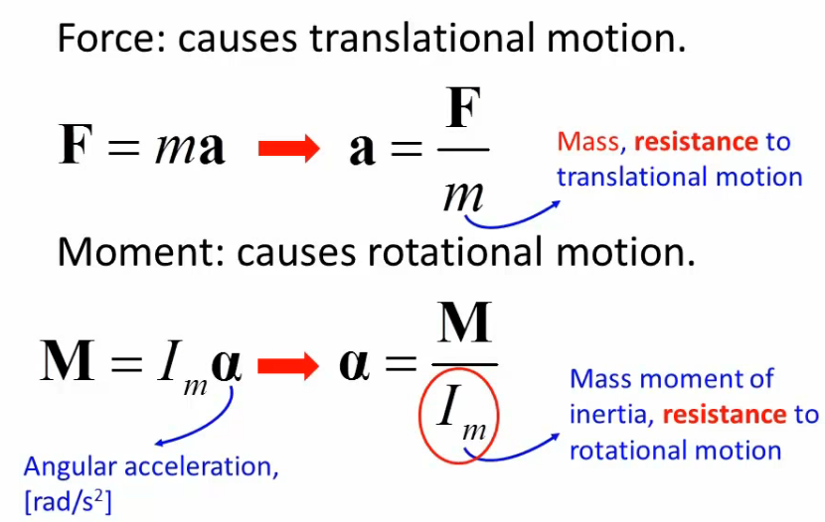

Slide 43
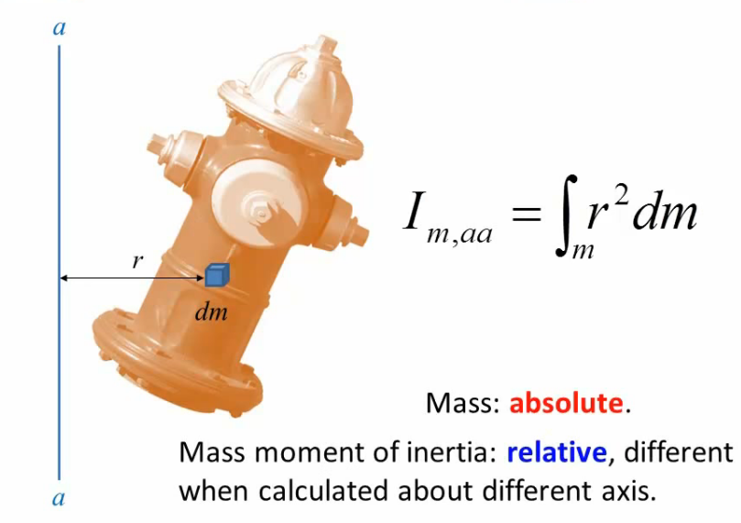
质量转动惯量

Slide 44
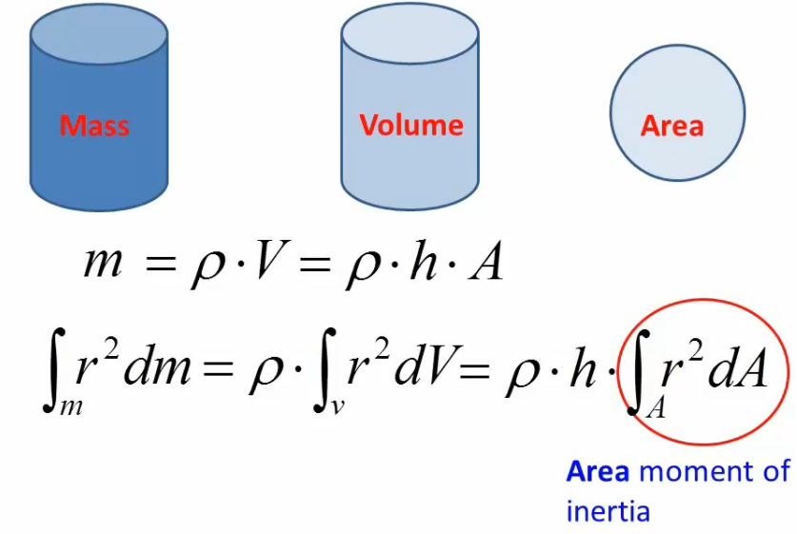
截面惯性矩是衡量截面抗弯能力的一个几何参数

Slide 45
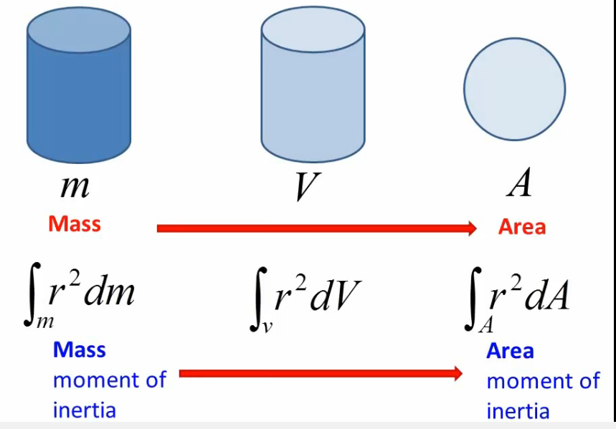

Slide 46
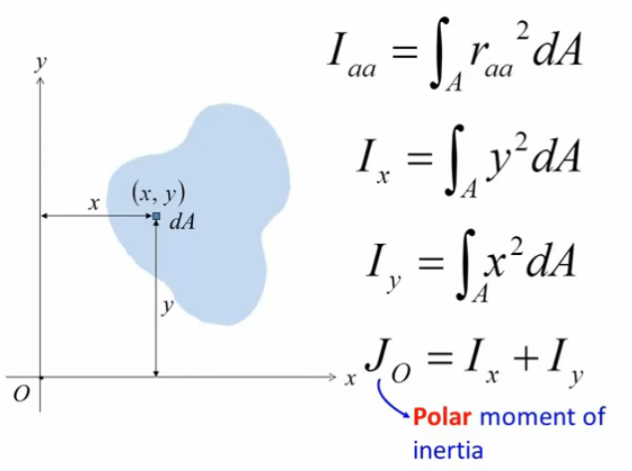
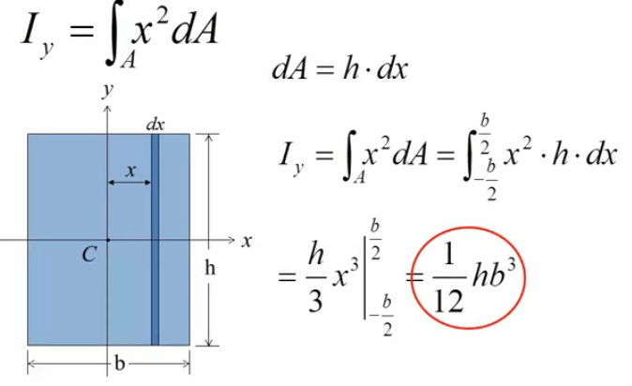
极惯性矩

Slide 47
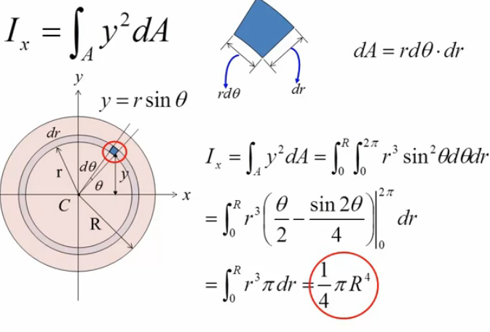
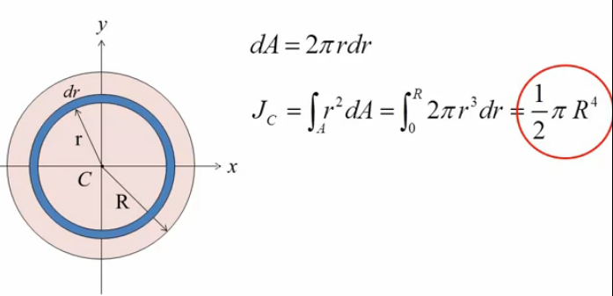

Slide 48
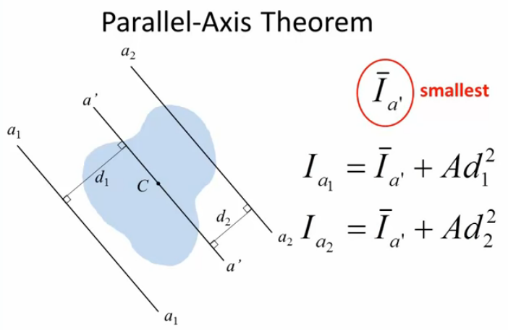

Slide 49
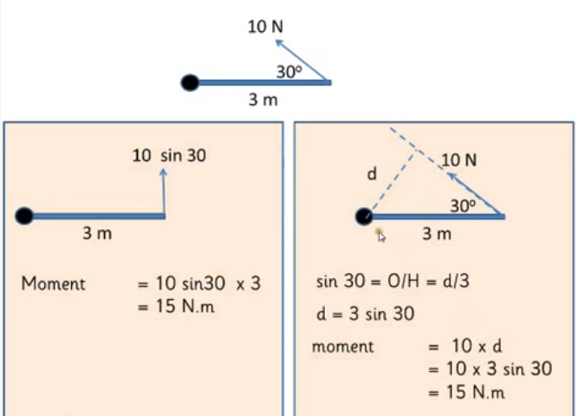

Slide 50
力矩
1）力矩 M=F ×d (力×力臂）
2)力偶：一对大小相等、方向向反，不在一条直线上的力系M=F ×d
F
d
d

Slide 51
力矩的应用
自行车的死点问题
力矩 M=F R cos θ 当角度θ =± 90°时，力矩 M=0，出现死点（用力效果为0，自行车不走）
F
R
脚蹬
θ

Slide 52
死点区
Φ

Slide 53
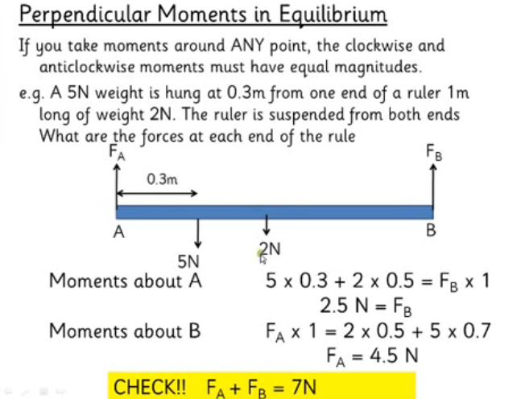

Slide 54
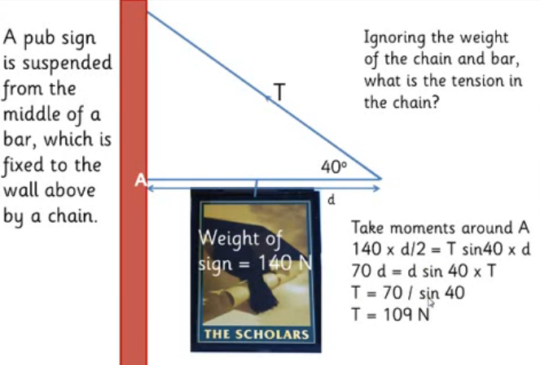

Slide 55




Slide 56


Slide 57


Slide 58


力偶矩
弯矩是受力构件截面上的内力矩的一种，即垂直于横截面的内力系的合力偶矩。

Slide 59


Slide 60


Slide 61



Slide 63




Slide 64


Slide 65


Slide 66


Slide 67



Slide 69

弯曲应力

Slide 70


Slide 71



Slide 72



Slide 73



c

Slide 74


Slide 75


Slide 76



Slide 77



Slide 78



Slide 79



Slide 80


Slide 81




